Slide 1
Welcome!
Sunday
Bible Study 9:30 AM
Worship 10:30 AM
Wednesday
Bible Class 7:00 PM
www.SunsetchurchofChrist.net

Slide 2
John 8:21-30
Jesus reveals His goal
Belief in Jesus
Speaking from the Father

Slide 3
Welcome!
Sunday
Bible Study 9:30 AM
Worship 10:30 AM
Wednesday
Bible Class 7:00 PM
www.SunsetchurchofChrist.net

Slide 4
Opening Prayer | Lamar McDonald
Song – | George Watkins
Scripture Reading | Michael Hetzer
Song – | George Watkins
Song – | George Watkins
Lord’s Supper | Michael Hetzer / Tacho Montanez
Song – | George Watkins
Collection | Michael Hetzer / Tacho Montanez
Song – | George Watkins
Lesson | Brian Haines
Song – | George Watkins
Closing | Anthony Ward

Slide 5
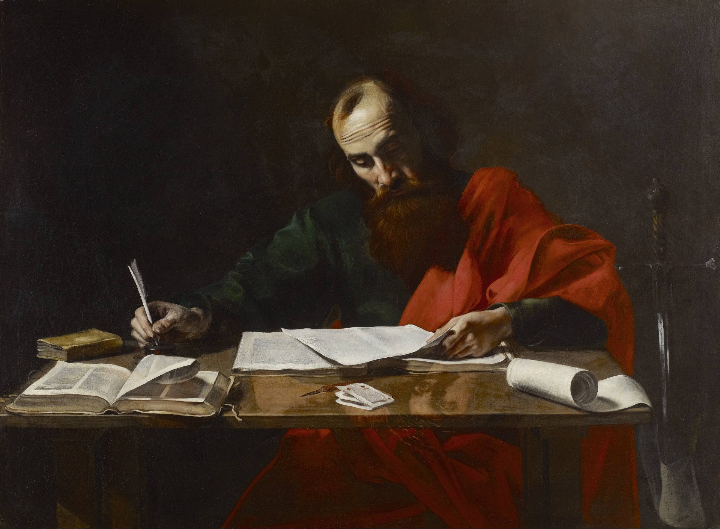
Paul’s Corinthian Advice
1 Corinthians 14
The Worship Assembly
Notes:
Begin reading at vs. 15

Slide 6
The Worship Assembly
Purpose of worship
- Praise and glorify God
- Giving of thanks
- Edification of Christians (1 Cor. 14)
Notes:
Ge 2:18 ¶ And the LORD God said, "It is not good that man should be alone; I will make him a helper comparable to him."

Slide 7
The Worship Assembly
Purpose of worship
Worship in the Old Testament
- The priestly observances
- Feast days: Holy Convocations
Notes:
Ge 2:18 ¶ And the LORD God said, "It is not good that man should be alone; I will make him a helper comparable to him."

Slide 8
The Worship Assembly
Context of 1 Corinthians 14
Chapter 11 – the worship assembly
Head covering
The Lord’s Supper
Acts 20:7

Slide 9
The Worship Assembly
Context of 1 Corinthians 14
Chapter 11 – the worship assembly
Chapter 12 – miraculous gifts
Chapter 13 – love for one another
The end of spiritual gifts
Notes:
Ge 2:18 ¶ And the LORD God said, "It is not good that man should be alone; I will make him a helper comparable to him."

Slide 10
The Worship Assembly
Using miraculous gifts in worship
Speaking in tongues
Prophesying
No longer with us

Slide 11
The Worship Assembly
Finding application in 1 Corinthians 14
- Decently and in order
- The unbeliever among us
- Not everyone speaks
One at a time
Women are “silent”

Slide 12
The Worship Assembly
Principles of worship
1) It is about God, not man

Slide 13
The Worship Assembly
Principles of worship
1) It is about God, not man
And Jesus answered him, “It is written, “‘You shall worship the Lord your God, and him only shall you serve.’” Luke 4:8

Slide 14
The Worship Assembly
Principles of worship
1) It is about God, not man
We are not pursing holy entertainment
We are seeking to please God

Slide 15
The Worship Assembly
Principles of worship
1) It is about God, not man
2) It is about holiness

Slide 16
The Worship Assembly
Principles of worship
1) It is about God, not man
2) It is about holiness
Give unto the LORD the glory due to His name; worship the LORD in the beauty of holiness. Psalm 29:2

Slide 17
The Worship Assembly
Principles of worship
1) It is about God, not man
2) It is about holiness
Prepared in our minds
Mindsets achieved ahead of time

Slide 18
The Worship Assembly
Principles of worship
1) It is about God, not man
2) It is about holiness
3) It is about sacrifice for our vow

Slide 19
The Worship Assembly
Principles of worship
1) It is about God, not man
2) It is about holiness
3) It is about sacrifice for our vow
Offer to God a sacrifice of thanksgiving, and pay your vows to the Most High; Psalm 50:14

Slide 20
The Worship Assembly
Principles of worship
1) It is about God, not man
2) It is about holiness
3) It is about sacrifice for our vow
Sacrificing time, effort, etc.
Our sacred confession

Slide 21
The Worship Assembly
Principles of worship
1) It is about God, not man
2) It is about holiness
3) It is about sacrifice for our vow
4) It is dangerous if done carelessly

Slide 22
The Worship Assembly
Principles of worship
1) It is about God, not man
2) It is about holiness
3) It is about sacrifice for our vow
4) It is dangerous if done carelessly
Walk prudently when you go to the house of God; and draw near to hear rather than to give the sacrifice of fools, for they do not know that they do evil. Ecclesiastes 5:1

Slide 23
The Worship Assembly
Principles of worship
1) It is about God, not man
2) It is about holiness
3) It is about sacrifice for our vow
4) It is dangerous if done carelessly
Worship exposes us to God

Slide 24
The Worship Assembly
We need to worship God
It is our part of the covenant
God deserves it
We are blessed by it – John 9:31

Slide 26
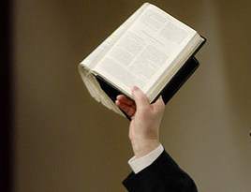
Acts 2:38 Then Peter said to them, "Repent, and let every one of you be baptized in the name of Jesus Christ for the remission of sins; and you shall receive the gift of the Holy Spirit.

